Slide 1

Building Software Systems for Electronic Design Automation
A software architecture overview
Rohit Priyadarshi

Slide 2
Overview
Electronic design automation is a very complex field with a mix of many different engineering disciplines:
Software Engineering
Electronics Engineering
Mechanical Engineering
Now we have proliferation of AI

Slide 3
Overview (Cont.)
EDA systems consists of toolchains that enable taking an electronic circuit from concept to a finished product
This consists of the ability to describe a design generally in form of Hardware Description Language
This description resembles quite a bit with programming languages like C, but describes the hardware
Since the designer may not necessarily target systems like FPGA, mathematical expressions will have to be generated in hardware
The process of converting the HDL to a form that maps to smaller components like logic gates is called Synthesis

Slide 4
Overview (Cont.)
These logic gates are prebuilt and stored in form of reusable libraries
In the last few decades, much larger components are prebuilt and sold as Ips
After synthesis, the design progresses to physical stages where it gets ready to be manufactured on silicon

Slide 5
Overview (Cont.)
These steps consist of, but not limited to:
Floor-planning
Pin assignment
Global placement
Detail placement
Global routing
Detail routing
Static timing analysis
Noise analysis
Parasitic extraction
Verification
…

Slide 6
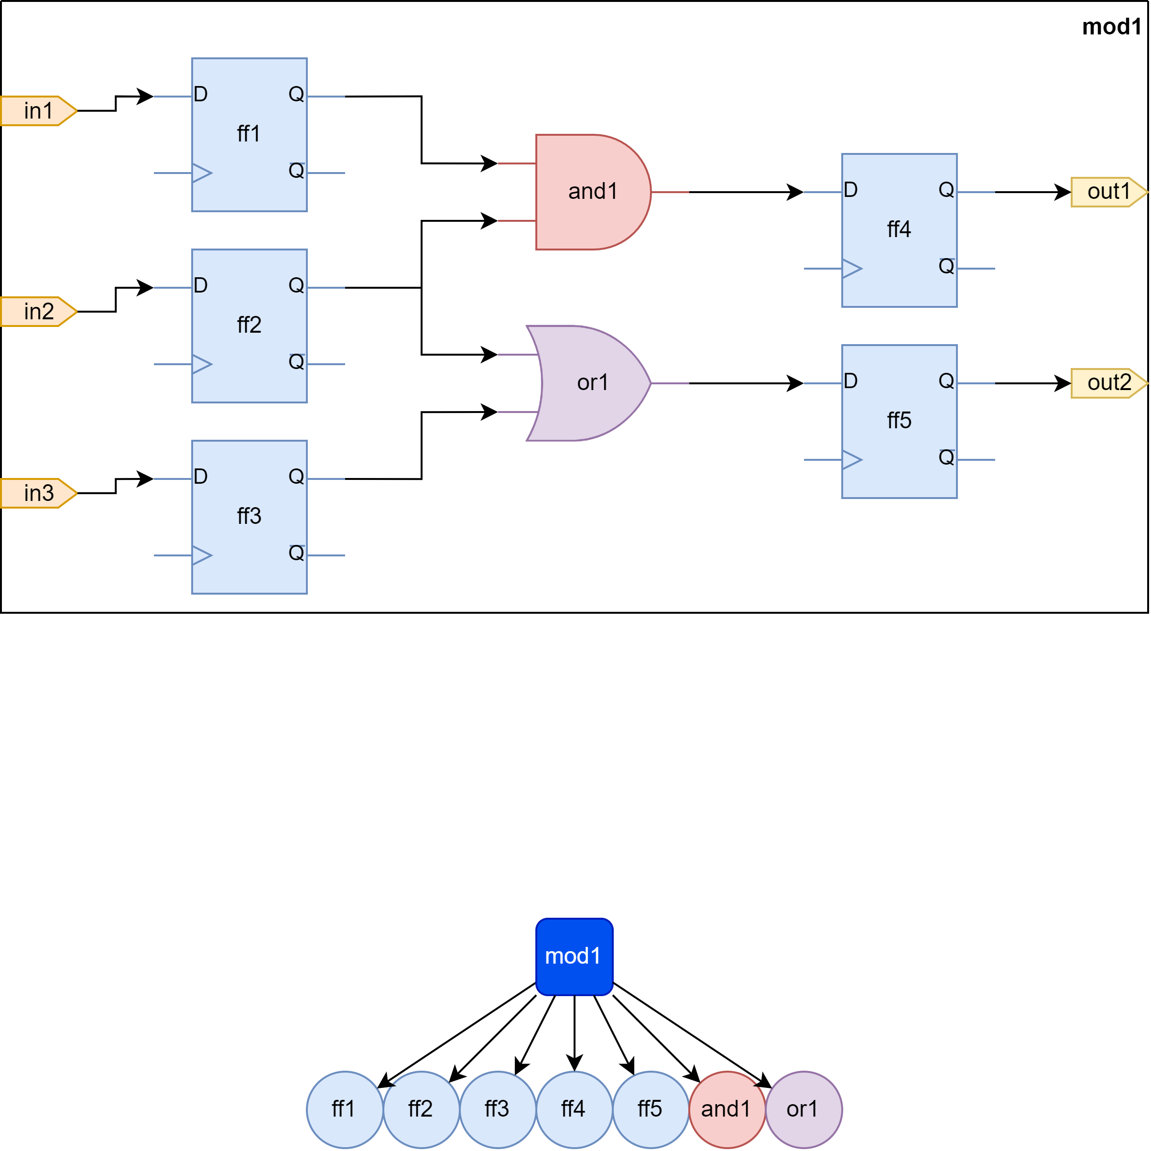
mod1
Some random module

Slide 7
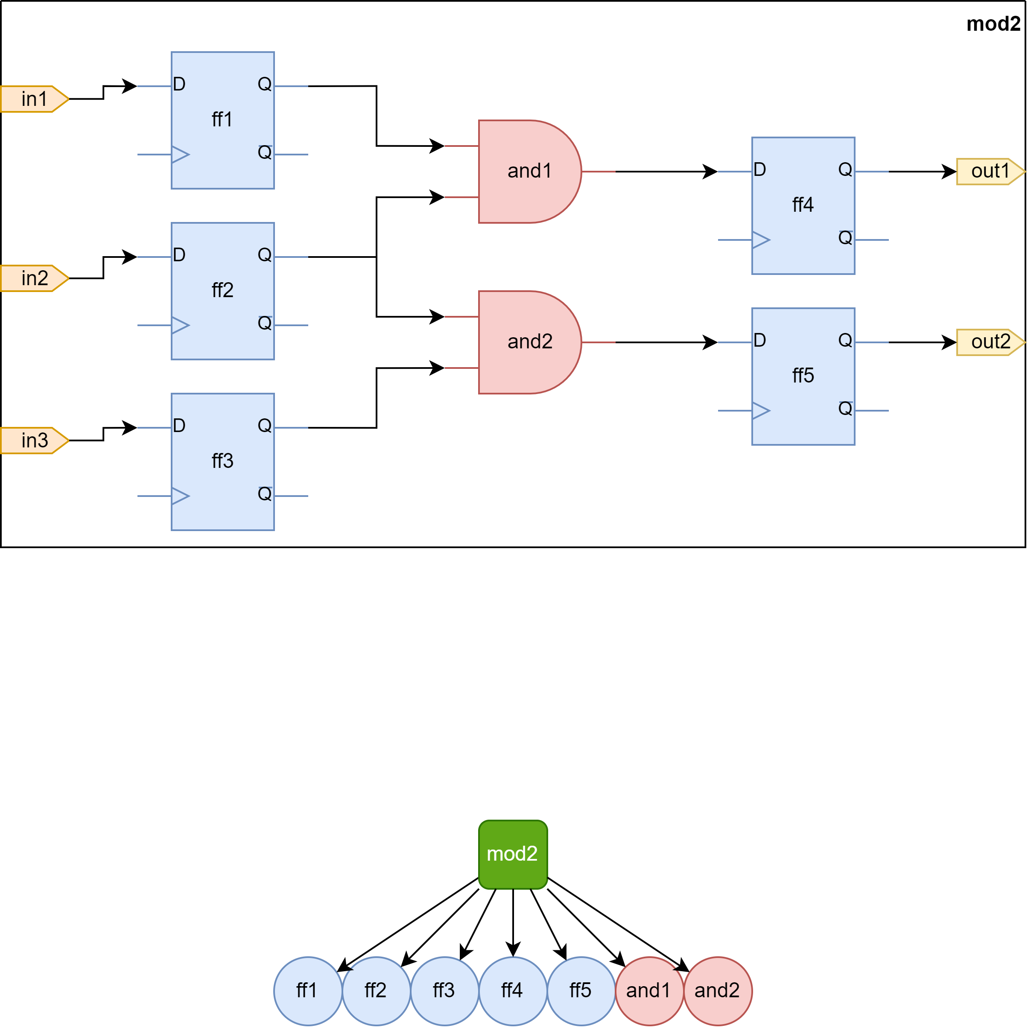
mod2
Some random module

Slide 8
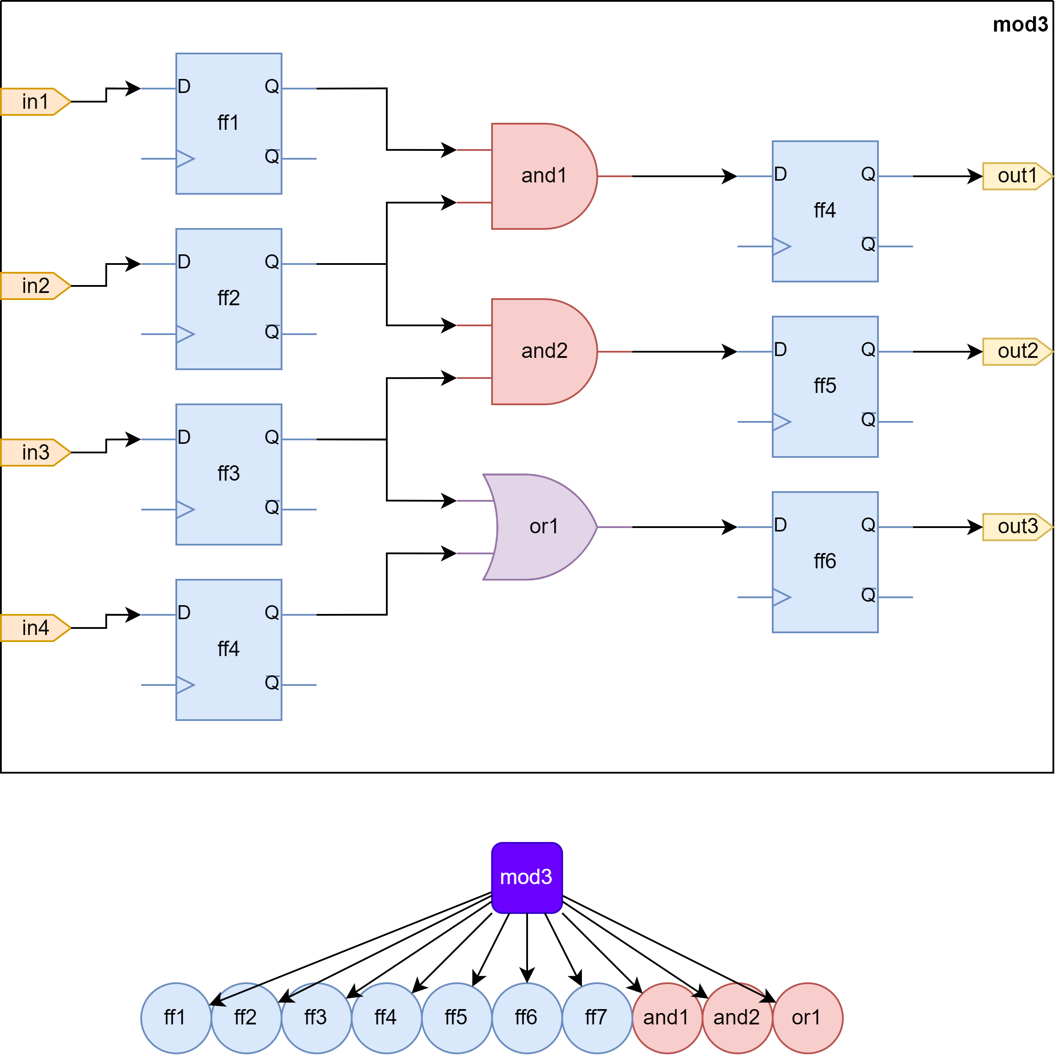
mod3
Some random module

Slide 9
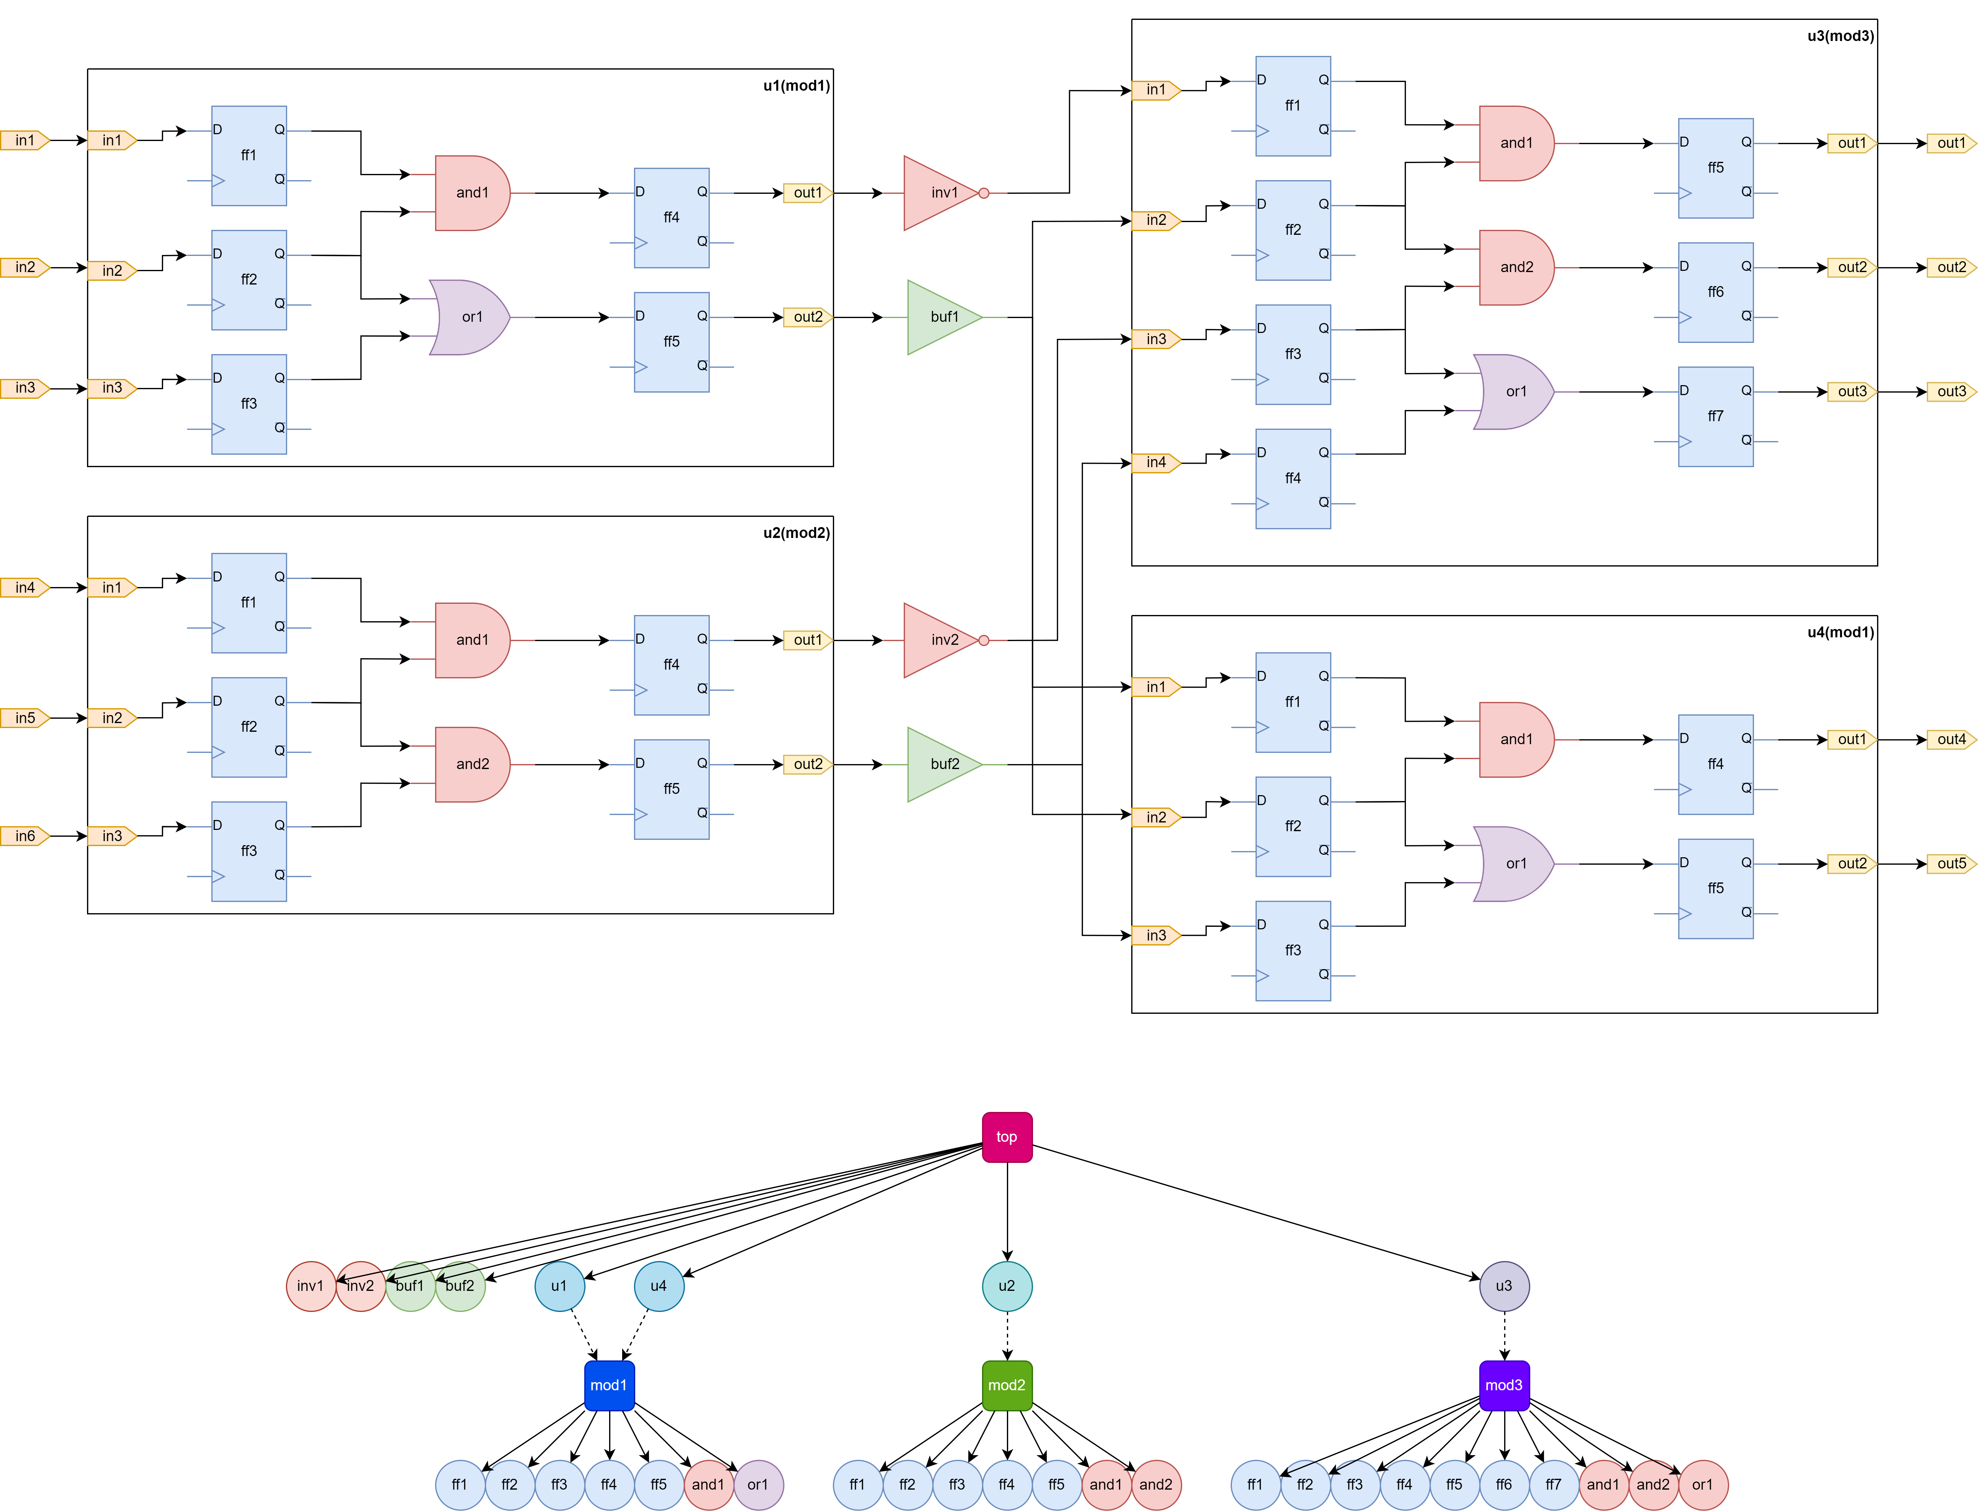
top
Random top module
Illustration of data-structure representing folded hierarchy

Slide 10
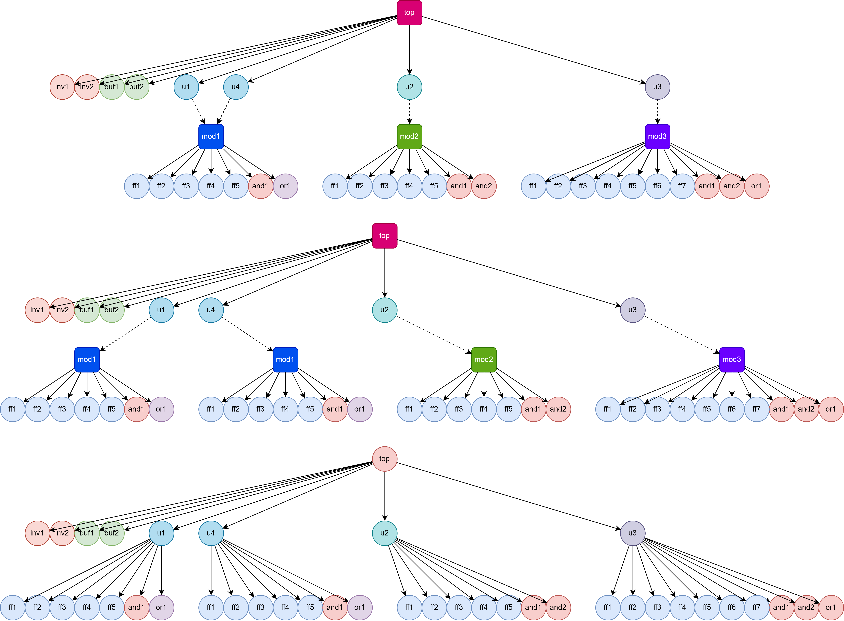
Instance Tree
Elaboration of folded module into a uniquified instance tree

Slide 11
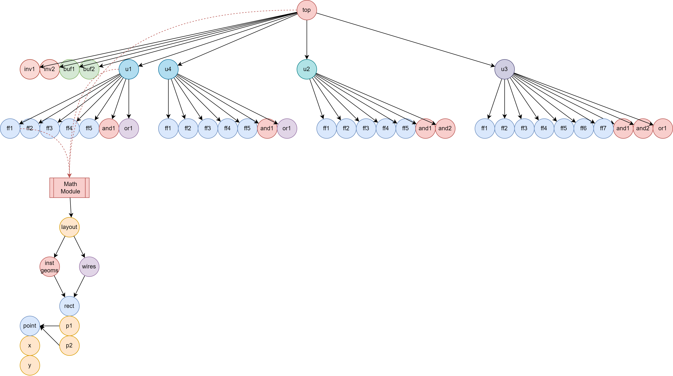
Embeddings
Data annotation, like geometries, timing etc.

Slide 12
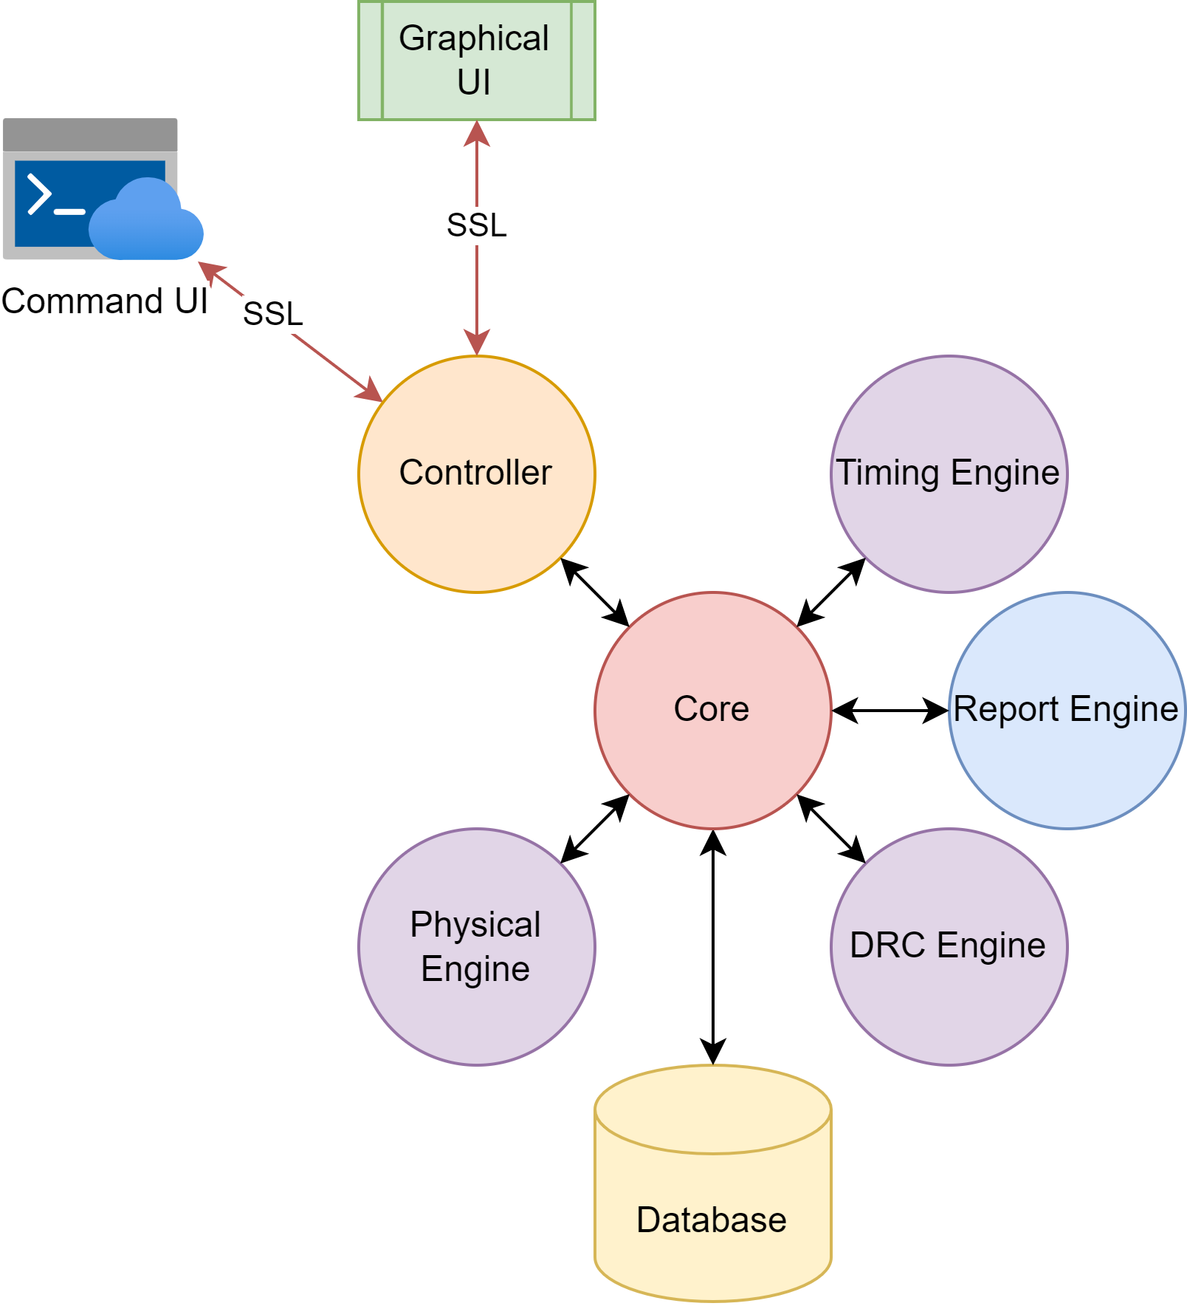
High-level Architecture

Slide 13
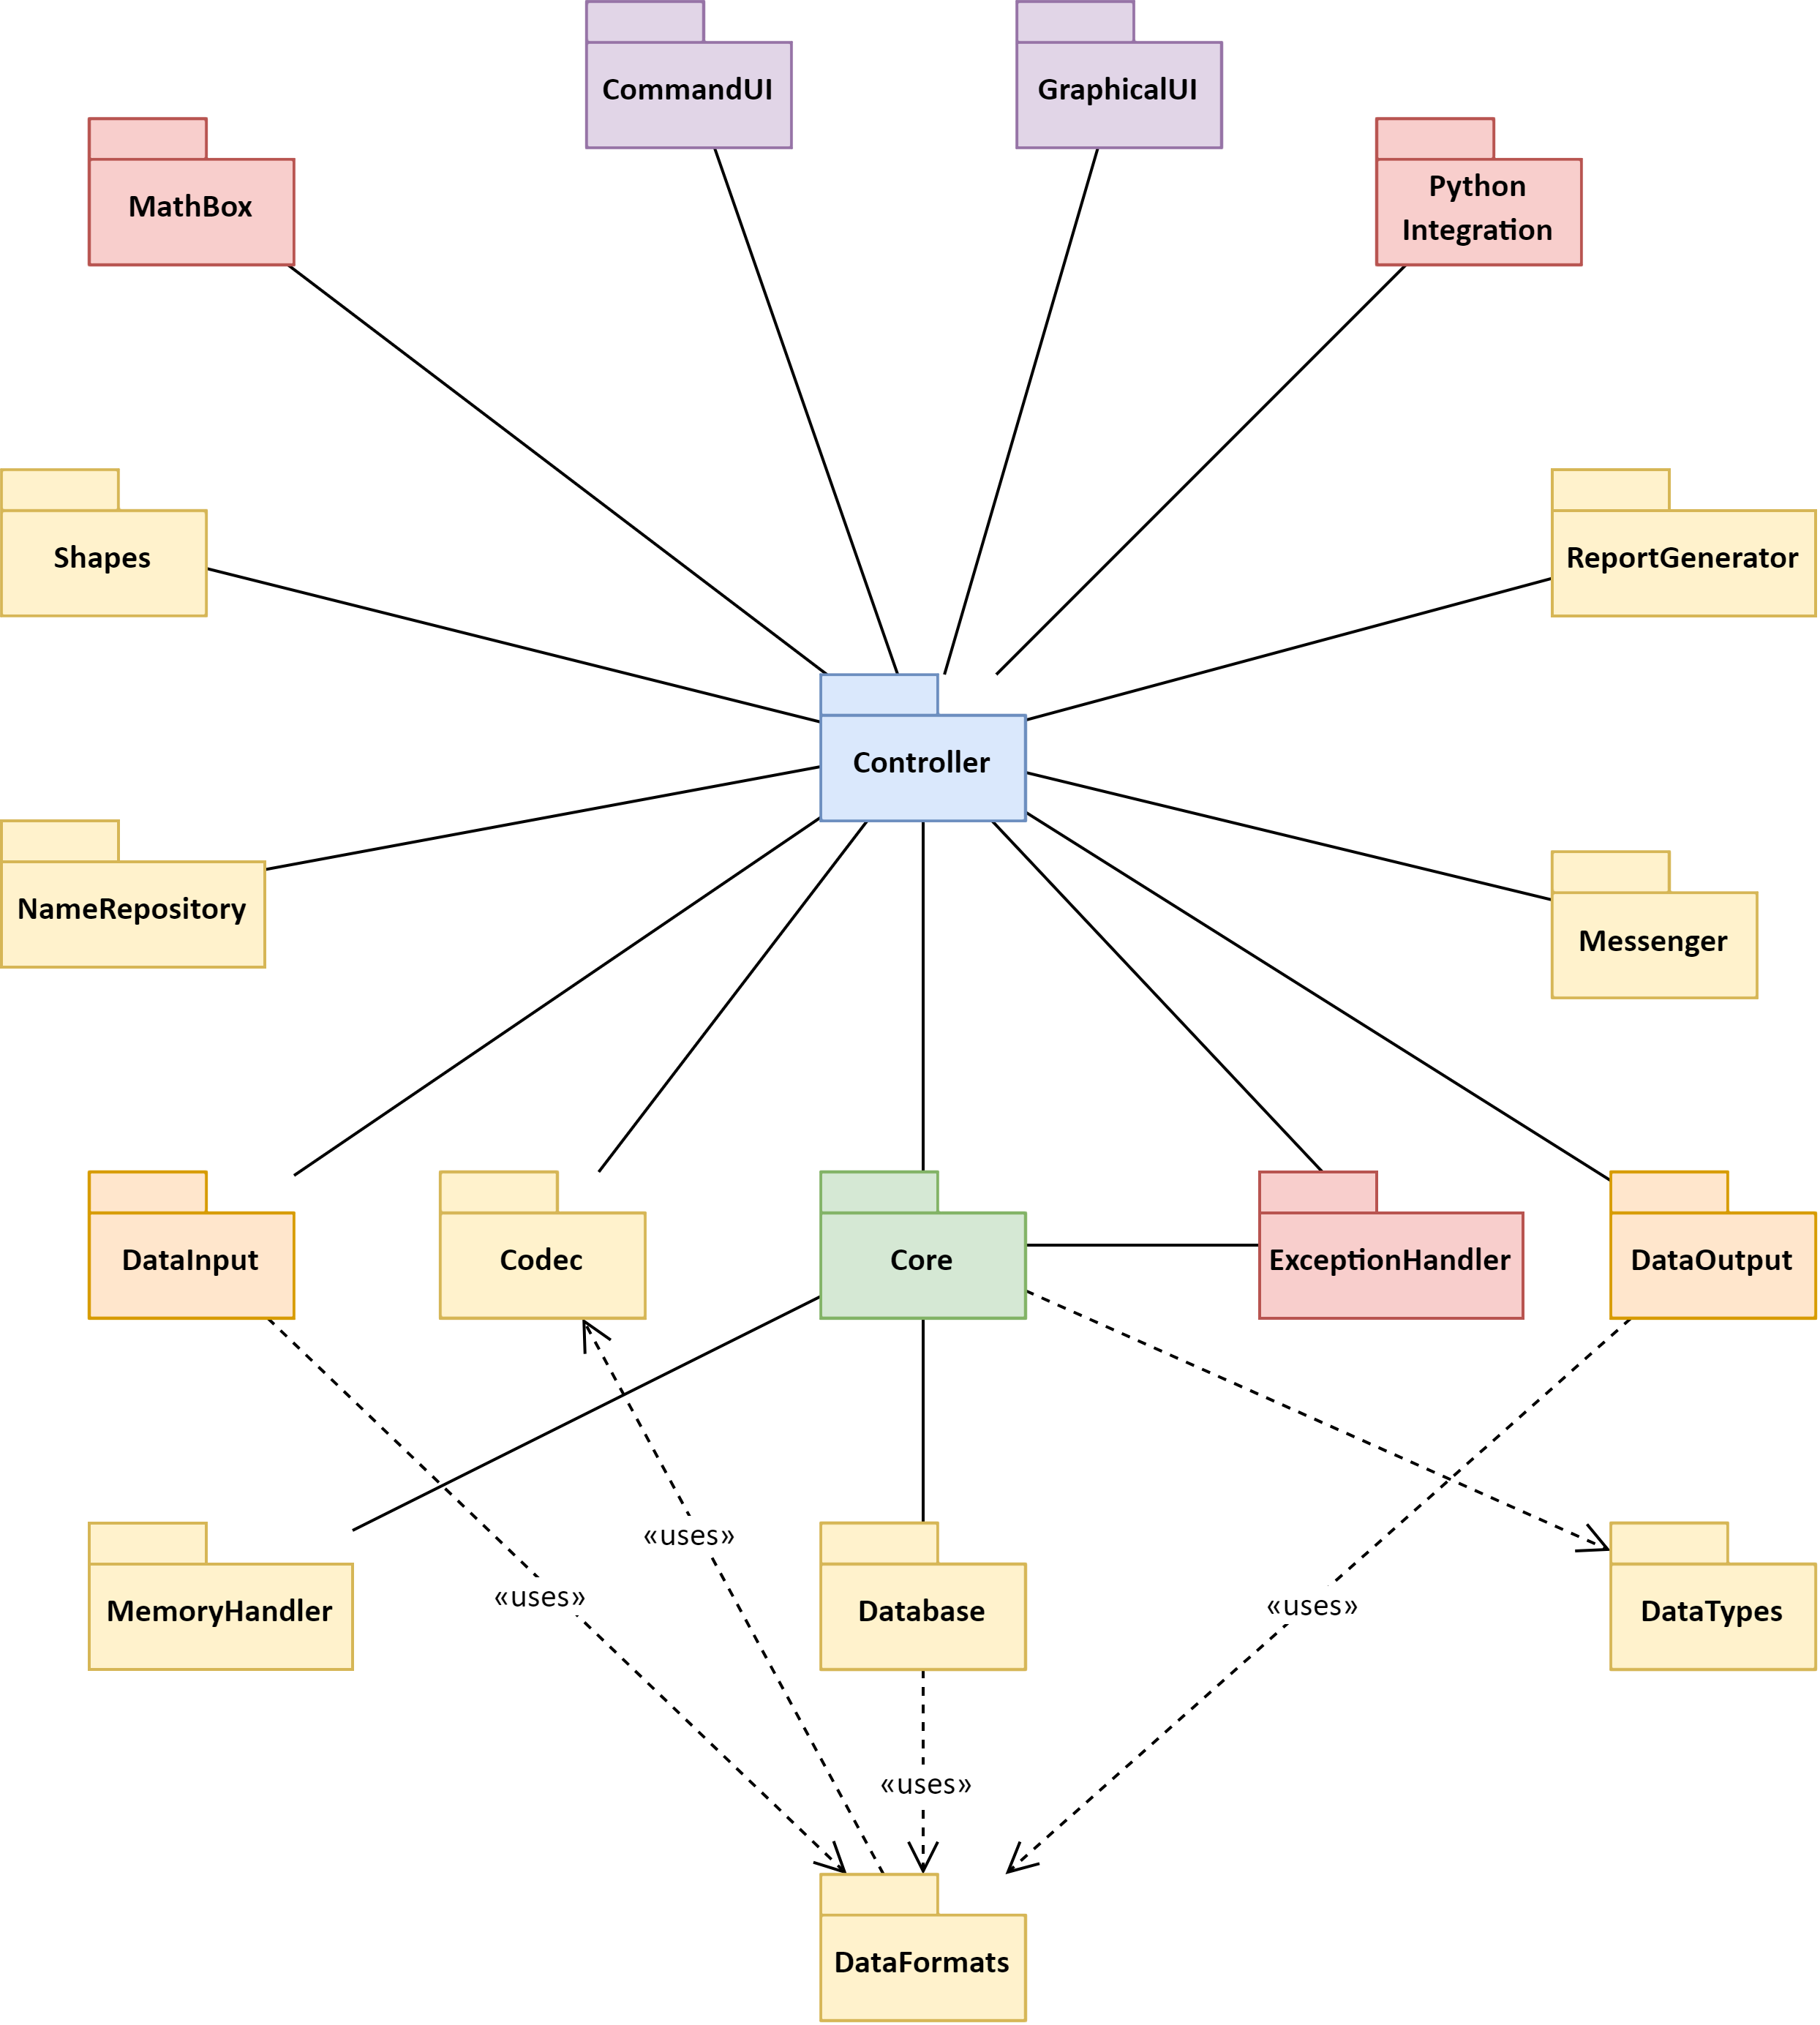
Components
The diagram here shows high level overview of an EDA framework

Slide 14
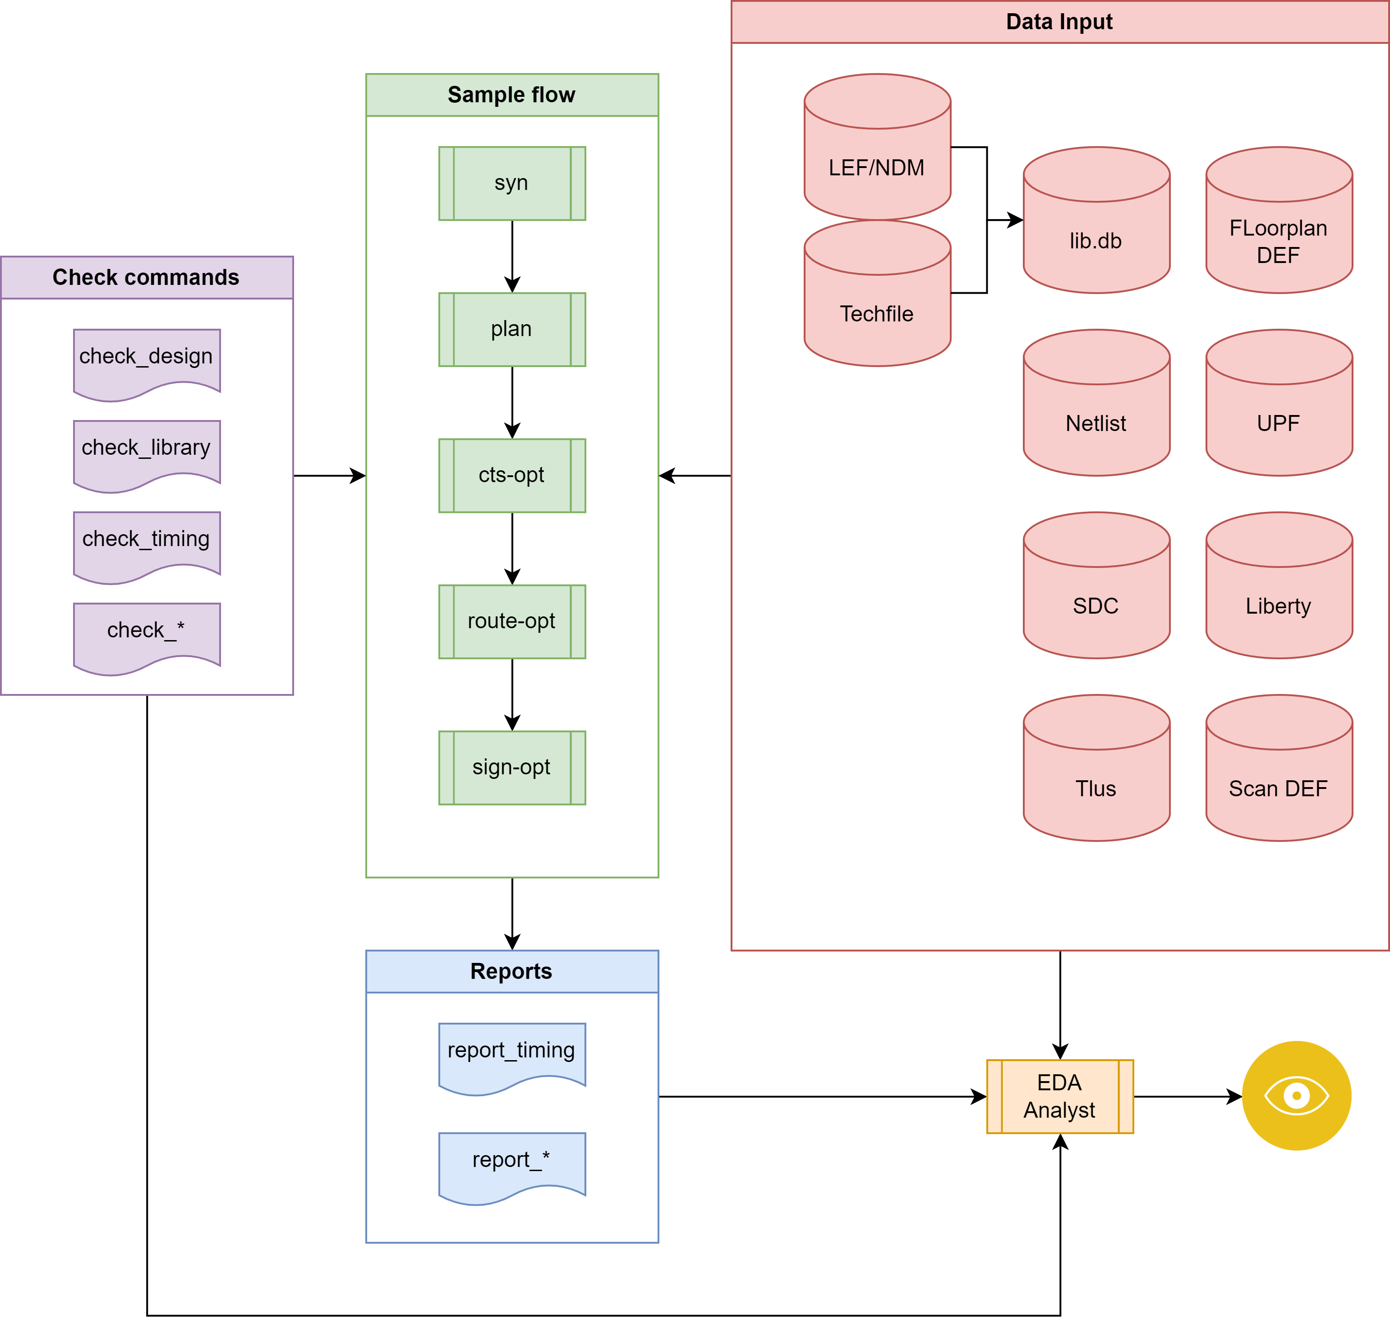
An example setup (courtesy Balaji)

Slide 15
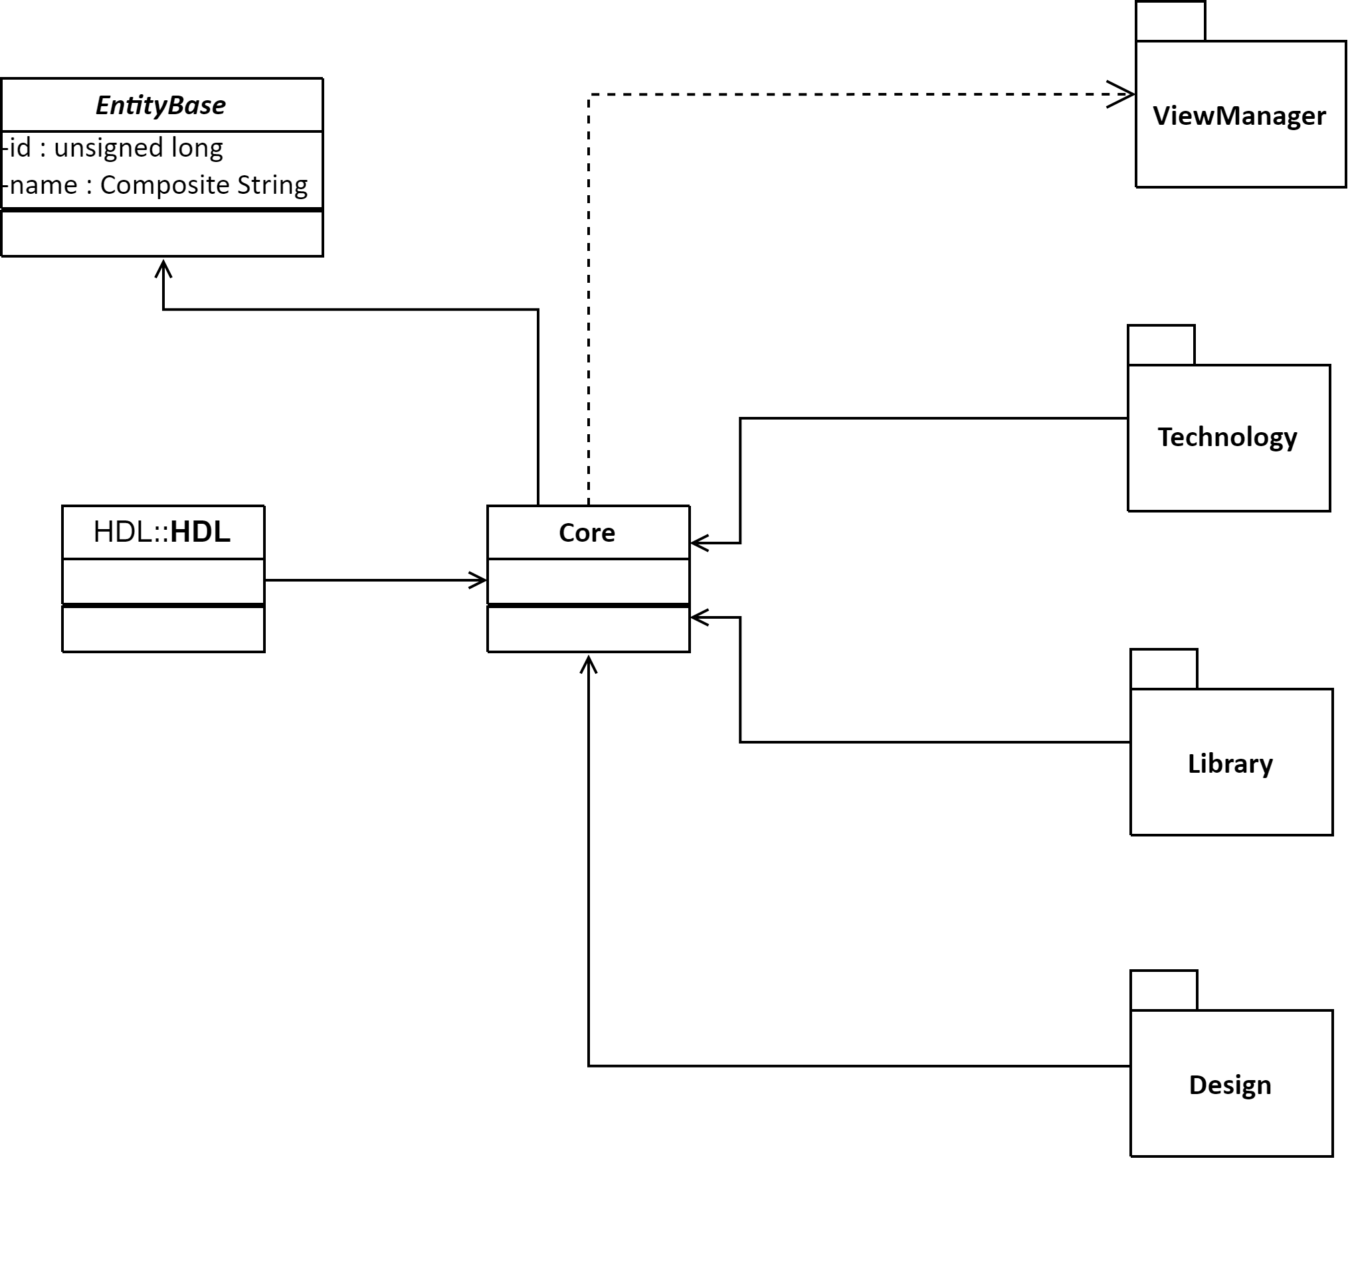
Core
Core class structure

Slide 16
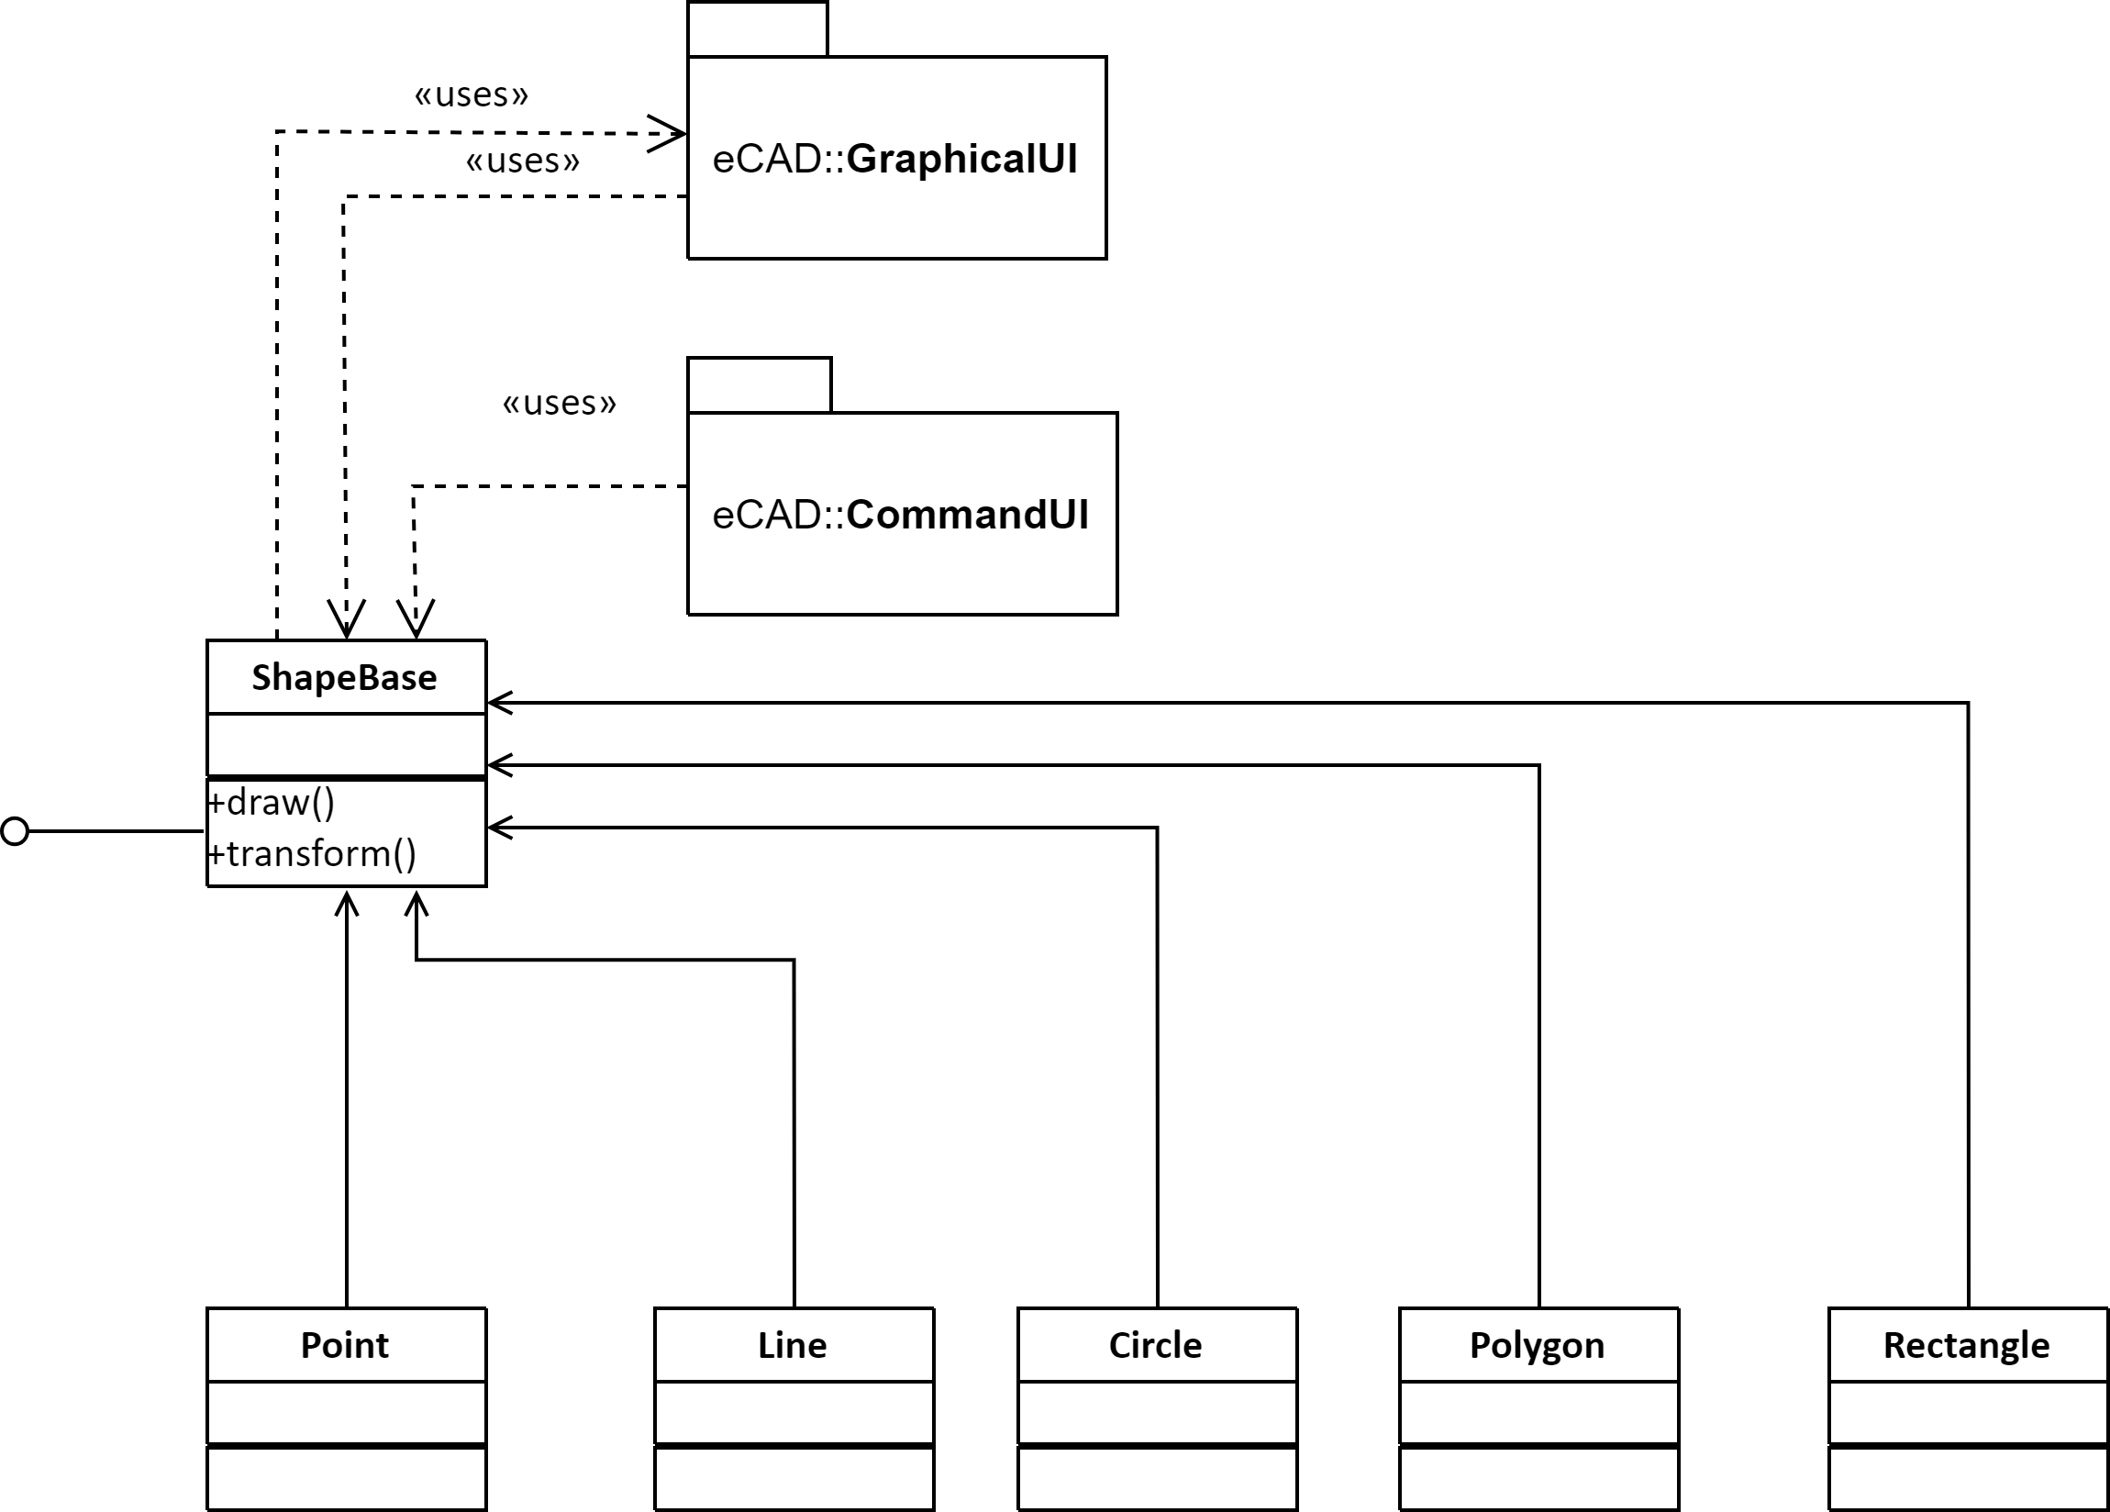
Shapes
Shape library

Slide 17
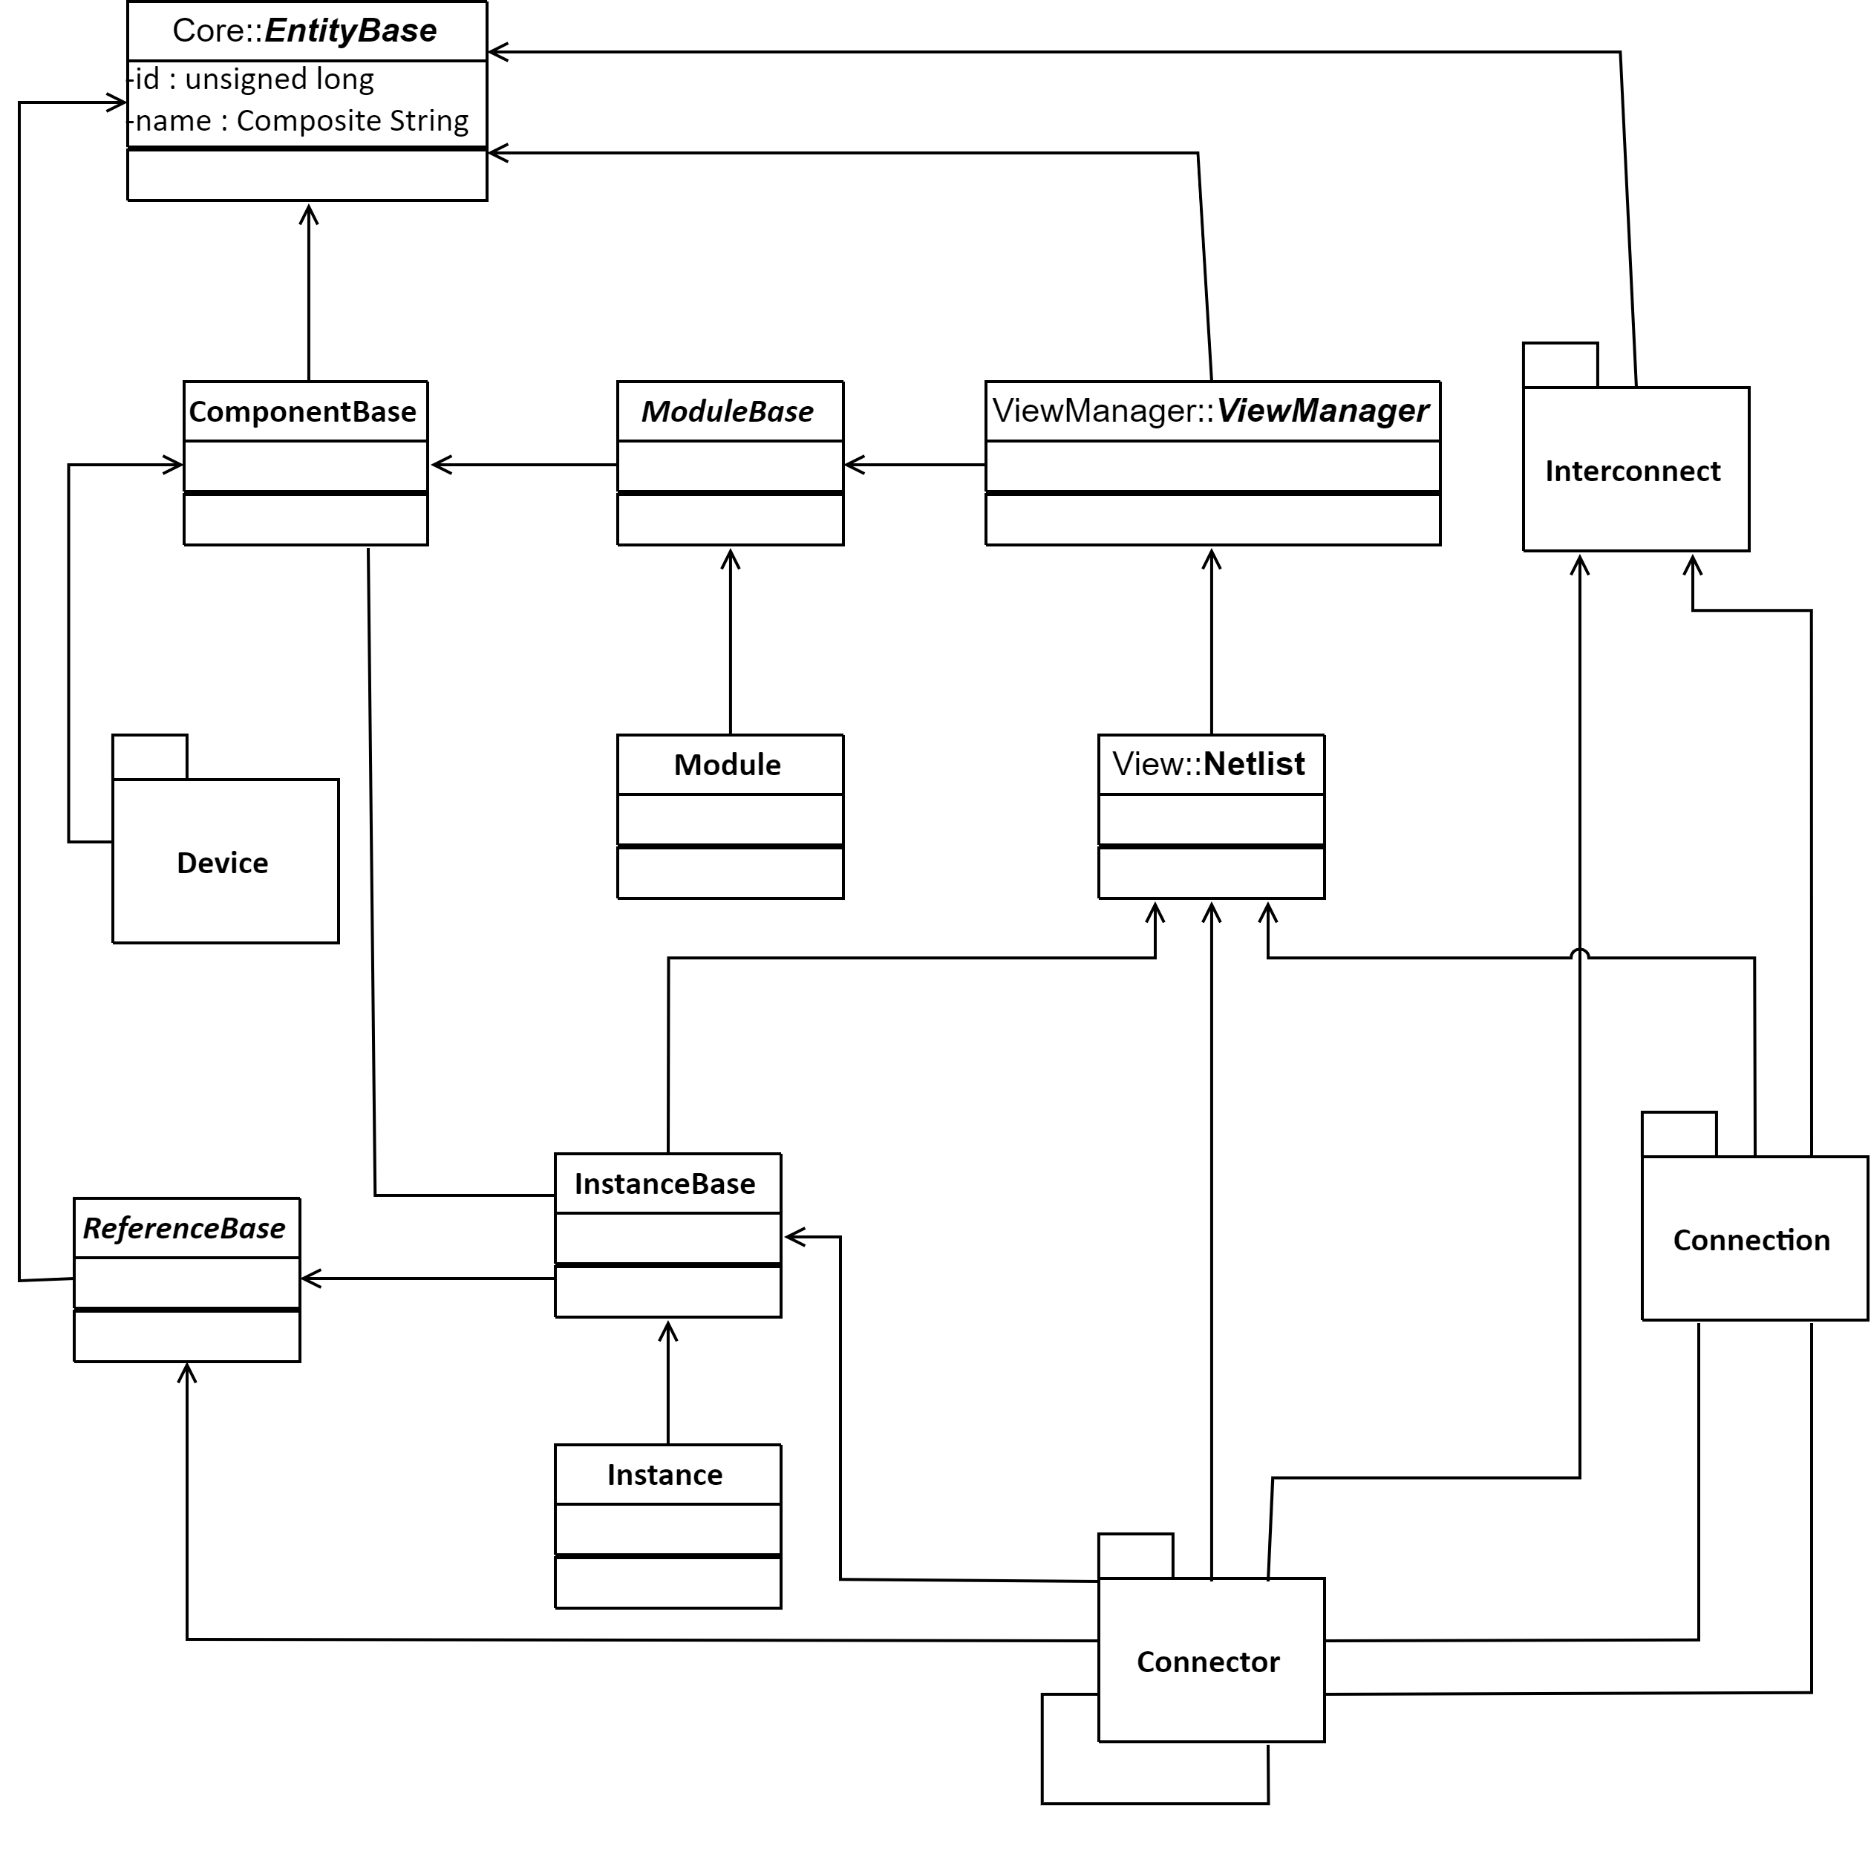
Netlist
Netlist model that represents a design

Slide 18
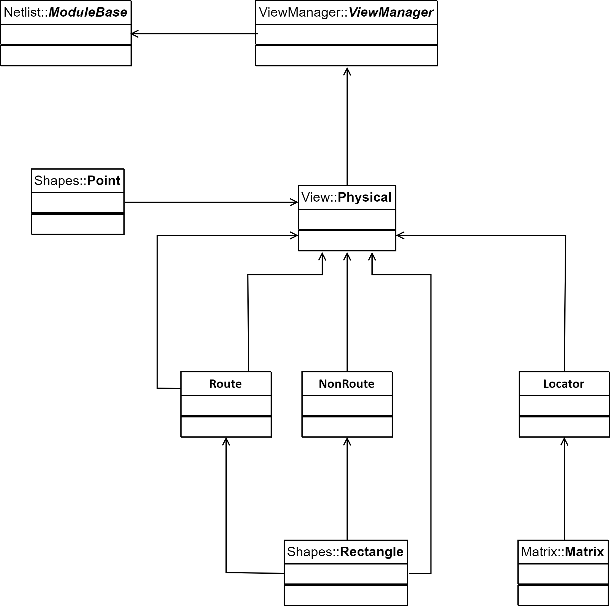
Physical
Physical data representation

Slide 19
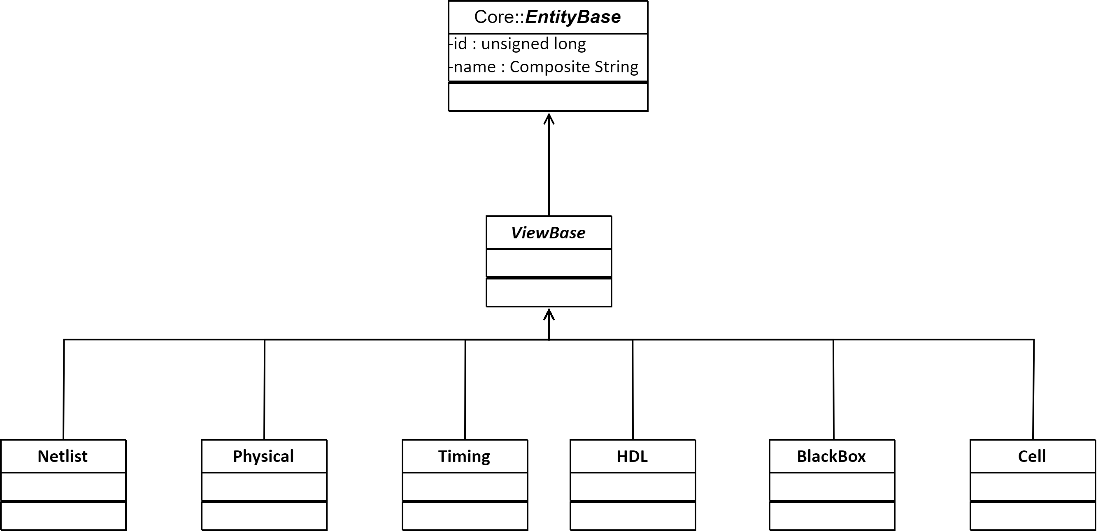
Views
Shows various representations and embeddings of a design

Slide 20
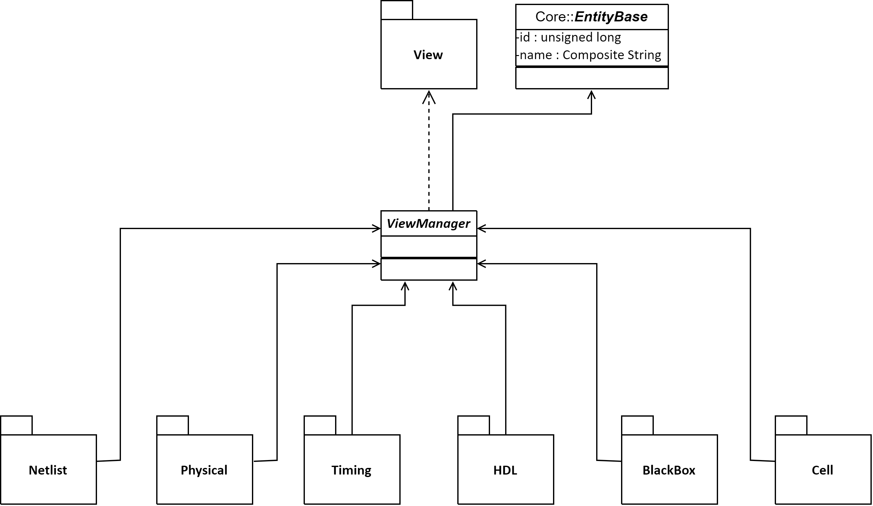
View Manager
Manages various representations and embeddings of a design

Slide 21
MVC Architecture
Controller is the command frontend
Controller has a server component
Controller uses gRPC based communication
GUI can be built using many different technologies including we based WebGL

Slide 22
Region Query
Quad Tree
HV/VH Tree
KD-Tree
Grid based

Slide 23
3rd Party Components
Google’s gRPC
Google’s Protobuf
Google’s GTEST
MD5/SHA-1/SHA-2 calculators
WebGL
Swig
C++ native threading library

Slide 24
DevOps
Git
Cmake
GNU Compilers for C/C++
Oracle Developer Studio
Python 3+
Tcl
Vscode
Jenkins
Draw.io
Code Review: Review Board: Time for a code review upgrade
Artifact managers: Downloads & Open Source Solutions for Developers and DevOps Experts | JFrog

Slide 25
Open-source EDA
Yosys Headquarters (github.com)
berkeley-abc/abc: ABC: System for Sequential Logic Synthesis and Formal Verification (github.com)
parallella/openeda: Open source EDA chip design flow (github.com)
steveicarus/iverilog: Icarus Verilog (github.com)
Veripool
GTKWave (sourceforge.net)
Silicon Integration Initiative | Si2 | Home

Slide 26
Outline
Slide 1 Overall - Application of the architecture
Slide 2 Software Architecture - Flow/Block Diagram
Slide 3 Highlight complex modules in the block diagram
Slide 4 Time taken to develop module w.r.t time/No of lines of code
Slide 5 Configuration/CPU/Memory Management of the architecture
Slide 6 Configurable/New or User defined objects
Slide 7 Web GUI architecture- Query & What-if analysis, Different Views
Slide 8 Security architecture of the Code/executable
Slide 9 Command interface – Data-models
Slide 10 Languages Used - Database, Frontend, Backend, GUI

